Slide 1
MAPREDUCE AND NEW SOFTWARE STACK

Slide 2
INTRODUCTION
Modern Data mining applications → big data analysis → it has immense amount of data to manage quickly.
In many of these applications, the data is extremely regular and there is a ample opportunity to exploit parallelism.
Examples:
  Page Ranking
  Friends network in Facebook
New Software stack → the programming design to get their parallelism not from a “Super Computer” , but from “Computing Cluster”

Slide 3
INTRODUCTION
Central to the new software stack is a programming system called MapReduce.
Implementations of MapReduce
  Performing computation on clusters efficiently
  Tolerant of hardware failure during the computation

Slide 4
DISTRIBUTED FILE SYSTEM
Most computing is done on a single processor, with its main memory, cache, and local disk (a compute node).
Single Node Architecture:
CPU
Machine Learning, Statistics
Memory
“Classical” Data Mining
Disk

Slide 5
DISTRIBUTED FILE SYSTEM
In past, applications that called for parallel processing → example large scientific calculations
  Uses special-purpose parallel computers with many processors and specialized hardware.
However, the prevalence of large-scale Web services has caused more and more computing to be done on installations with thousands of compute nodes operating more or less independently.
  Computing nodes → commodity hardware

Slide 6
DISTRIBUTED FILE SYSTEM
Physical Organization of Compute Nodes:
  Compute nodes are stored on racks, perhaps 8–64 on a rack.
  The nodes on a single rack are connected by a network. → gigabit Ethernet
  There can be many racks of compute nodes,.
  Racks are connected by another level of network or a switch.
  The bandwidth of inter-rack communication high
  There is possibility of failure like single node failure , loss of entire rack, etc
    Files must be stored redundantly.
    Computation must be divided into tasks

Slide 7
CLUSTER ARCHITECTURE
2-10 Gbps backbone between racks
1 Gbps between
any pair of nodes
in a rack
Switch
Switch
Switch
CPU
CPU
CPU
CPU
Mem
…
Mem
Mem
…
Mem
Disk
Disk
Disk
Disk
Each rack contains 16-64 nodes

Slide 8
DISTRIBUTED FILE SYSTEM
Large-Scale File-System Organization:
  To exploit cluster computing, files must look and behave somewhat differently from the conventional file systems found on single computers. → This new file system often called Distributed File System (DFS)
  There are several DFS are available
    GFS
    HDFS
    CloudStore
  Files can be enormous, possibly a terabyte in size.
    If you have only small files, there is no point using a DFS
  Files are rarely updated.
  Files are divided into Chucks. ~64MB, 128MB

Slide 9
DISTRIBUTED FILE SYSTEM
Large-Scale File-System Organization:
  Chunks are replicated, perhaps three times, at three different compute nodes.
  It uses Rack-aware principle for replication of chunks in file system.
  Master node or Name node is used to find the chunks of a file.

Slide 10
MAP REDUCE
MapReduce is a style of computing that has been implemented in several systems.
The popular open-source implementation Hadoop which can be obtained, along with the HDFS file system from the Apache Foundation.
Two Functions:
  Map
  Reduce

Slide 11
MAP REDUCE
Some number of Map tasks each are given one or more chunks from a distributed file system.
These Map tasks turn the chunk into a sequence of key-value pairs.
The way key-value pairs are produced from the input data is determined by the code written by the user for the Map function.
The key-value pairs from each Map task are collected by a master controller and sorted by key.
The keys are divided among all the Reduce tasks, so all key-value pairs with the same key wind up at the same Reduce task.

Slide 12
MAP REDUCE
The Reduce tasks work on one key at a time, and combine all the values associated with that key in some way.
The manner of combination of values is determined by the code written by the user for the Reduce function.

Slide 13
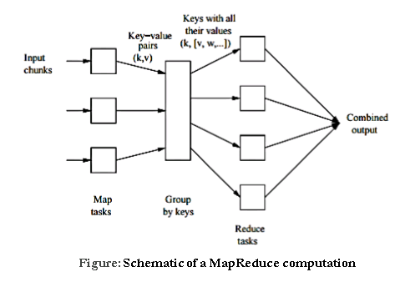
MAP REDUCE

Slide 14
MAP TASKS
The input files for a Map task as consisting of elements, which can be any type. → tuple or document
A chunk is a collection of elements and no element is stored across two chunks
Insisting on (Key, Value) form for inputs and outputs → to allow composition of several MapReduce processes.
The Map function takes an input element as its argument and produces zero or more key-value pairs.
Rather a Map task can produce several key-value pairs with the same key, even from the same element.

Slide 15
GROUP BY KEY
As soon as the Map tasks have all completed successfully, the key-value pairs are grouped by key, and the values associated with each key are formed into a list of values.
The grouping is performed by the system, regardless of what the Map and Reduce tasks do.
The master controller process knows how many Reduce tasks there will be, say “r” such tasks.
The master controller picks a hash function that applies to keys and produces a bucket number from 0 to (r-1)
Each key that is output by a Map task is hashed and its key-value pair is put in one of r local files.
Each file is destined for one of the Reduce tasks.

Slide 16
REDUCE TASKS
The Reduce function’s argument is a pair consisting of a key and its list of associated values.
The output of the Reduce function is a sequence of zero or more key-value pairs.
These key-value pairs can be of a type different from those sent from Map tasks to Reduce tasks
The application of the Reduce function to a single key and its associated list of values as a reducer.
The outputs from all the Reduce tasks are merged into a single file.

Slide 17
MAP REDUCE EXAMPLE
Counting the number of occurrences for each word in a collection of documents.
Input: repository of documents and each document is an element
Output: word and its frequency
The Map function for this example uses keys that are of type String (the words) and values that are integers.
The Map task reads a document and breaks it into its sequence of words w₁,w₂, . . . ,w_{n}.
It then emits a sequence of key-value pairs where the value is always 1.
The output of the Map task for this document is the sequence of key-value pairs: (w₁,1), (w₂,1), … (w_{n},1)

Slide 18
MAP REDUCE EXAMPLE
Counting the number of occurrences for each word in a collection of documents.
Input: repository of documents and each document is an element
Output: word and its frequency
The Reduce function simply adds up all the values.
The output of a reducer consists of the word and the sum.
The output of all the Reduce tasks is a sequence of (w,m) pairs
  w is a word that appears at least once among all the input documents
  m is the total number of occurrences of w-among all those documents.

Slide 19
MAP REDUCE EXAMPLE
Counting the number of occurrences for each word in a collection of documents.
  Input: repository of documents and each document is an element
  Output: word and its frequency
  map(key, value):
  /* key: document name; value: text of the document for each word w in value: */
  emit(w, 1)
  reduce(key, values):
  // key: a word; value: an iterator over counts
  result = 0
  for each count v in values:
  result += v
  emit(key, result)

Slide 20
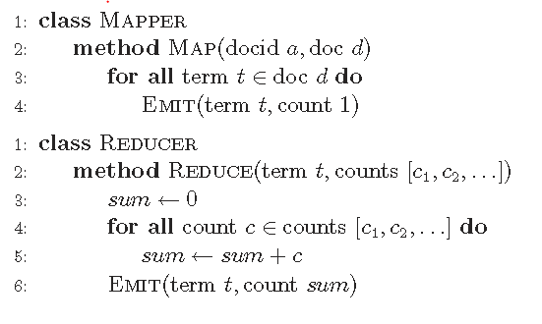
MAP REDUCE EXAMPLE
Counting the number of occurrences for each word in a collection of documents.
Pseudo-code for the word count algorithm in MapReduce

Slide 21
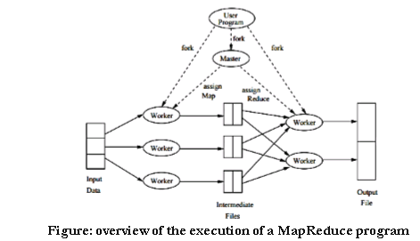
MAP REDUCE EXECUTION

Slide 22
MAP REDUCE ALGORITHMS: VECTOR MULTIPLICATION
Vector Multiplication:
  Vector → simply array of numbers
Task: Multiply 2 array of N-numbers
  Assume N is very large
  Assume two vectors A and B
  Multiplication process is
    First element of vector – A is multiply with first element of Vector – B,…. At the end all those terms are summed.
Two vector files are large and partitioned are in HDFS

Slide 23
MAP REDUCE ALGORITHMS: VECTOR MULTIPLICATION
Design Consideration:
  Need Elements with same index grouped together and multiply
  <key,value> = <index, number>
Problem:
  Array partitions does not have an index.
  Configuration settings are used to get some extra information about data → this information can be achieved by mapper using special calls during execution. → os.getenv(),..
let us assume, each line has <key,value> = <index,number>

Slide 24
MAP REDUCE ALGORITHMS: VECTOR MULTIPLICATION
Example in the class room

Slide 25

MAP REDUCE ALGORITHMS: MATRIX VECTOR MULTIPLICATION
A Matrix – M has dimension n X n and Vector – V of length as n.
m_{ij} denotes the element in i^{th} row and j^{th} column.
v_{j} denote j^{th} element in Vector – V.
Then the matrix-vector product is the vector – x of length – n, whose i^{th} element x_{i} is given by

Slide 26
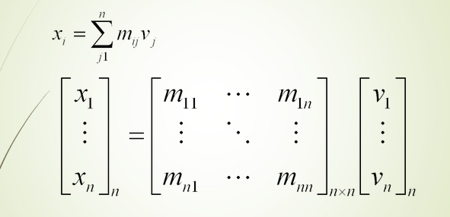
MAP REDUCE ALGORITHMS: MATRIX VECTOR MULTIPLICATION

Slide 27
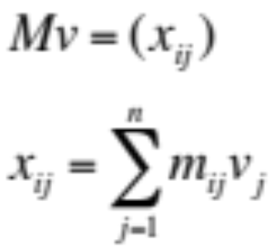

MAP REDUCE ALGORITHMS: MATRIX VECTOR MULTIPLICATION
If n = 1000, no need of MapReduce!
n
M
v
n

Slide 28
MAP REDUCE ALGORITHMS: MATRIX VECTOR MULTIPLICATION
Case – 1: Large n, M does not fit into main memory, but v does → M and V will be stored in DFS
  Since v fits into main memory, v is available to every map task. → So v is read into main memory at the compute node executing a map task:
  Let us assume row-column coordinates of each matrix element will be discoverable
  Map Phase:
    for each matrix element m_{ij}, emit key value pair (i, m_{ij}v_{j})
  Shuffle and Sorting:
    groups all m_{ij}v_{j} values together for the same i
  Reduce Phase:
    sum m_{ij}v_{j} for all j for the same i

Slide 29


MAP REDUCE ALGORITHMS: MATRIX VECTOR MULTIPLICATION
Case – II: The vector does not fit in memory
For every map, many accesses to disk (for parts of v) required!
Partition v and rows of M so that each partition of v fits into memory
Take dot product of one partition of v and the corresponding partition of M
Map and reduce same as before
This much will fit into main memory
This whole chunk does not fit in main memory anymore

Slide 30
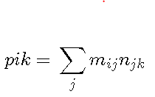
MAP REDUCE ALGORITHMS: MATRIX MULTIPLICATION
If M is a matrix with element m_{ij} in row i and column j, and N is a matrix with element n_{jk} in row j and column k, then the product: P = MN
is the matrix P with element p_{ik} in row i and column k, where:

Slide 31
MAP REDUCE ALGORITHMS: MATRIX MULTIPLICATION
We can think of a matrix M and N as a relation with three attributes:
  the row number,
  the column number and
  the value in that row and column,
M(I,J,V) and N(J,K,W) with the following tuples, respectively: (i; j;m_{ij}) and (j; k; n_{jk}).
In case of sparsity of M and N, this relational representation is very efficient in terms of space.
The product MN is almost a natural join followed by grouping and aggregation.

Slide 32
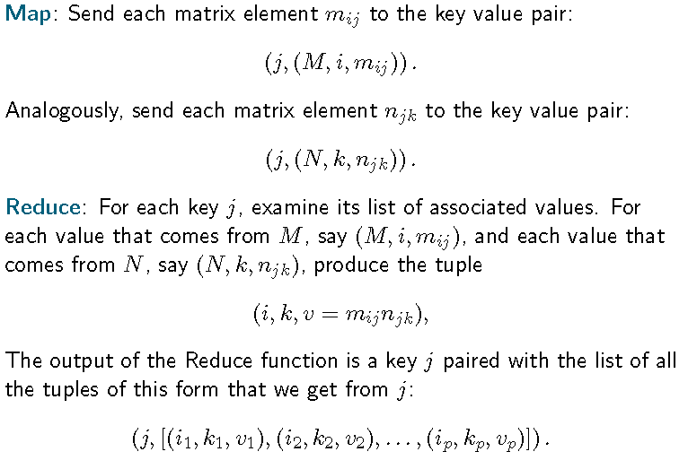
MAP REDUCE ALGORITHMS: MATRIX MULTIPLICATION

Slide 33
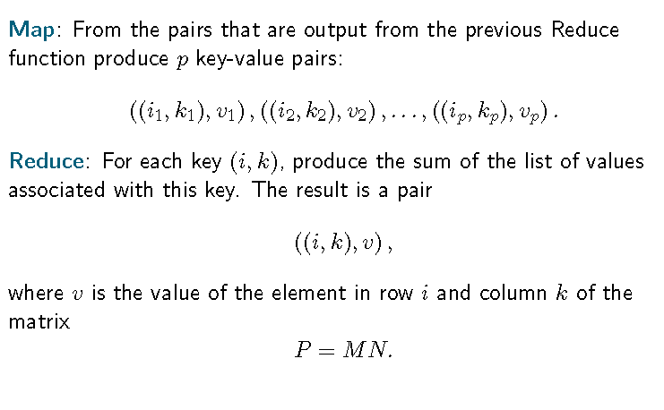
MAP REDUCE ALGORITHMS: MATRIX MULTIPLICATION

Slide 34
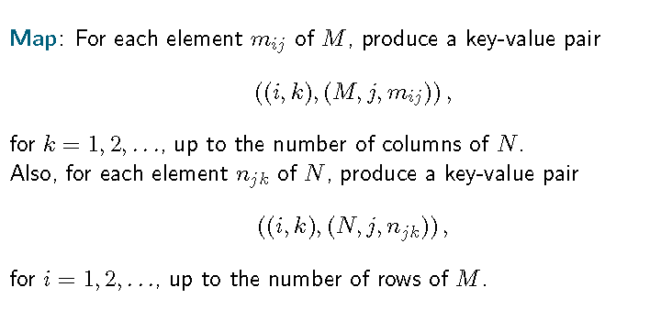
MAP REDUCE ALGORITHMS: MATRIX MULTIPLICATION – ONE STEP

Slide 35
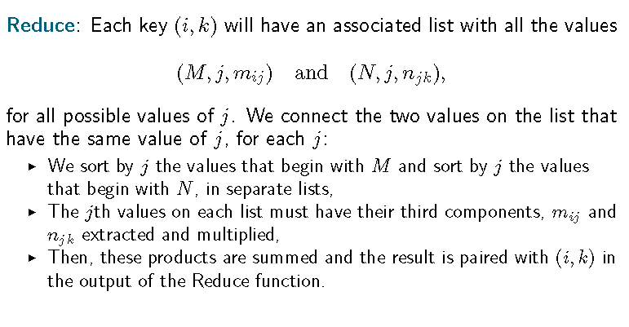
MAP REDUCE ALGORITHMS: MATRIX MULTIPLICATION – ONE STEP

Slide 36
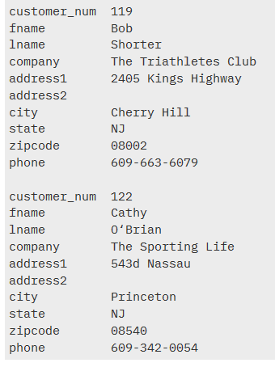
MAP REDUCE ALGORITHMS: RELATIONAL ALGEBRA OPERATIONS
Selection:
  Apply a condition C to each tuple in the relation and produce as output only those tuples that satisfy C.
  The result of this selection is denoted σC(R).
  Example:
  SELECT * FROM customer
  WHERE state = 'NJ';

Slide 37
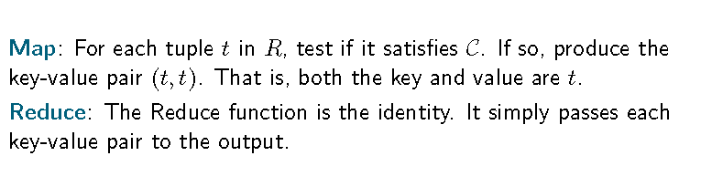
MAP REDUCE ALGORITHMS: RELATIONAL ALGEBRA OPERATIONS
Selection:

Slide 38
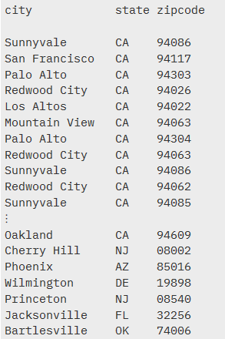
MAP REDUCE ALGORITHMS: RELATIONAL ALGEBRA OPERATIONS
Projection:
  For some subset S of the attributes of the relation, produce from each tuple only the components for the attributes in S.
  The result of this projection is denoted πS(R).
  Example: SELECT city, state,
  zipcode FROM customer;

Slide 39
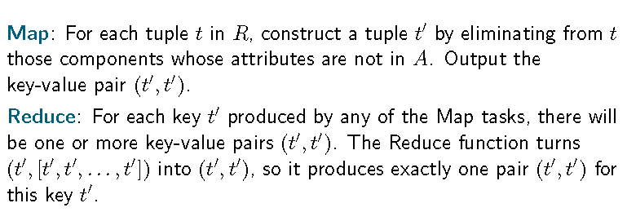
MAP REDUCE ALGORITHMS: RELATIONAL ALGEBRA OPERATIONS
Projection:
  ;

Slide 40
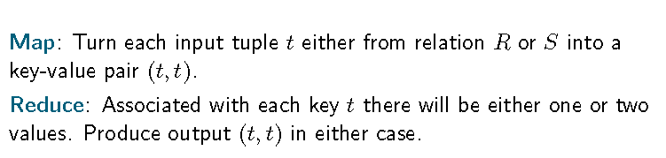
MAP REDUCE ALGORITHMS: RELATIONAL ALGEBRA OPERATIONS
Union, Intersection, and Difference:
  These well-known set operations apply to the sets of tuples in two relations that have the same schema.
Union:

Slide 41
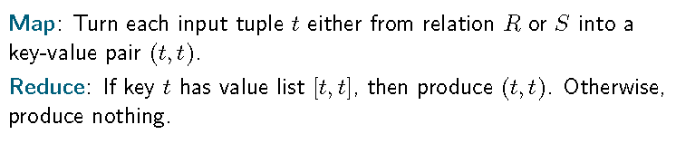
MAP REDUCE ALGORITHMS: RELATIONAL ALGEBRA OPERATIONS
Union, Intersection, and Difference:
  These well-known set operations apply to the sets of tuples in two relations that have the same schema.
Intersection:

Slide 42
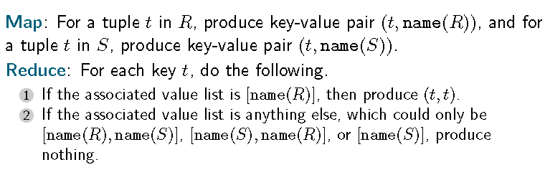
MAP REDUCE ALGORITHMS: RELATIONAL ALGEBRA OPERATIONS
Union, Intersection, and Difference:
  These well-known set operations apply to the sets of tuples in two relations that have the same schema.
Difference:

Slide 43
MAP REDUCE ALGORITHMS: RELATIONAL ALGEBRA OPERATIONS
Natural Join:
  Given two relations, compare each pair of tuples, one from each relation.
  If the tuples agree on all the attributes that are common to the two schemas, then produce a tuple that has components for each of the attributes in either schema and agrees with the two tuples on each attribute.
  If the tuples disagree on one or more shared attributes, then produce nothing from this pair of tuples.
  The natural join of relations R and S is denoted R ⊲⊳ S

Slide 44
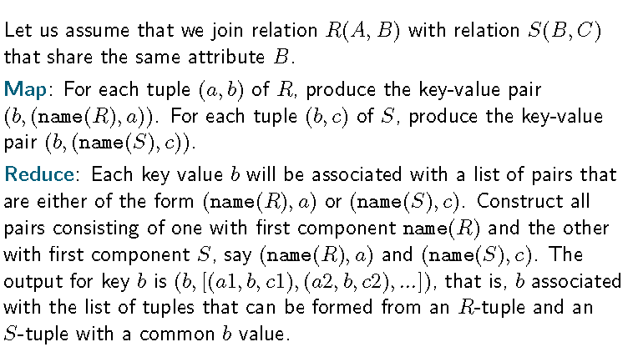
MAP REDUCE ALGORITHMS: RELATIONAL ALGEBRA OPERATIONS
Natural Join:

Slide 45
MAP REDUCE ALGORITHMS: RELATIONAL ALGEBRA OPERATIONS
Grouping and Aggregation:
  Given a relation R, partition its tuples according to their values in one set of attributes G, called the grouping attributes.
  Then, for each group, aggregate the values in certain other attributes.
  The normally permitted aggregations are SUM, COUNT, AVG, MIN, and MAX, with the obvious meanings.
  We denote a grouping-and-aggregation operation on a relation R by γX(R), where X is a list of elements that are either
    A grouping attribute, or
    An expression θ(A), where θ is one of the five aggregation operations such as SUM, and A is an attribute not among the grouping attributes.

Slide 46
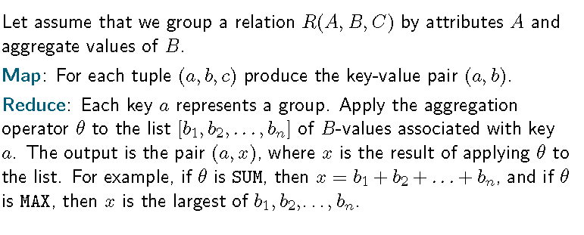
MAP REDUCE ALGORITHMS: RELATIONAL ALGEBRA OPERATIONS
Grouping and Aggregation:

Slide 47
MAP REDUCE ALGORITHMS: EXERCISES
Use Case – I:
Let us try to find the paths of length two in the Web, using the relation Links. That is, we want to find the triples of URL’s (u, v,w) such that there is a link from u to v and a link from v to w. We essentially want to take the natural join of Links with itself, but we first need to imagine that it is two relations, with different schemas, so we can describe the desired connection as a natural join. Thus, imagine that there are two copies of Links, namely L1(U1,U2) and L2(U2,U3).

Slide 48
MAP REDUCE ALGORITHMS: EXERCISES
Now, if we compute L1 ⊲⊳ L2, we shall have exactly what we want. That is, for each tuple t1 of L1 (i.e., each tuple of Links) and each tuple t2 of L2 (another tuple of Links, possibly even the same tuple), see if their U2 components are the same. Note that these components are the second component of t1 and the first component of t2. If these two components agree, then produce a tuple for the result, with schema (U1,U2,U3). This tuple consists of the first component of t1, the second component of t1 (which must equal the first component of t2), and the second component of t2. We may not want the entire path of length two, but only want the pairs (u,w) of URL’s such that there is at least one path from u to w of length two. If so, we can project out the middle components by computing πU1,U3(L1 ⊲⊳ L2).

Slide 49
MAP REDUCE ALGORITHMS: EXERCISES
Use case – II
Imagine that a social-networking site has a relation Friends(User, Friend). This relation has tuples that are pairs (a, b) such that b is a friend of a. The site might want to develop statistics about the number of friends members have. Their first step would be to compute a count of the number of friends of each user. This operation can be done by grouping and aggregation, specifically γUser,COUNT(Friend)(Friends). This operation groups all the tuples by the value in their first component, so there is one group for each user. Then, for each group the count of the number of friends of that user is made. The result will be one tuple for each group, and a typical tuple would look like (Sally, 300), if user “Sally” has 300 friends.

Slide 50
MAP REDUCE ALGORITHMS: EXERCISES
Use case – III
Design MapReduce algorithms to take a very large file of integers and produce as output:
  The largest integer.
  The average of all the integers.
  The same set of integers, but with each integer appearing only once.
  The count of the number of distinct integers in the input.

Slide 51
EXTENSION TO MAP REDUCE:
MapReduce has proved so influential that it has spawned a number of extensions and modifications
The extended systems share common characteristics with Map Reduce
  They are built on a distributed file system.
  They manage very large numbers of tasks that are instantiations of a small number of user-written functions.
  They incorporate a method for dealing with most of the failures that occur during the execution of a large job, without having to restart that job from the beginning.

Slide 52
EXTENSION TO MAP REDUCE:
Workflow Systems:
  Clustera and Hyracks are extend of Map Reduce from the simple two-step workflow (Map to Reduce) to any number of functions.
  These systems uses acyclic graph representation of workflow among the functions
  An acyclic flow graph whose arcs a → b represent the fact that function a’s output is input to function b.

Slide 53
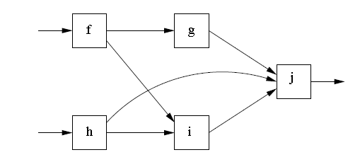
EXTENSION TO MAP REDUCE:
Workflow Systems:
  five functions, f through j
  Data passes from left to Right in specific ways
  Flow of data is acyclic
  No task needs to provide data out before its input is available.
  Here
    h takes input from preexisting file from DFS
    h’s output elements is passed to at least one of the functions i and j

Slide 54
EXTENSION TO MAP REDUCE:
Workflow Systems:
  Each function of a workflow can be executed by many tasks.
  Each of the task is assigned a portion of the input to the function
  A master controller is responsible for dividing the work among the tasks that implement a function.
    Hashing
  Thus, like Map tasks, each task implementing a function f has an output file of data destined for each of the tasks that implement the successor function(s) of f. These files are delivered by the Master at the appropriate time – after the task has completed its work.

Slide 55
EXTENSION TO MAP REDUCE:
Workflow Systems:
  The function of workflow and the tasks share with Map Reduce tasks → Only deliver output after they complete
  If a task fails → it will not deliver output to any of its successors in the flow graph.
  Master Controller can restart the failed task at another compute node.
  Simply cascades of Map Reduce jobs
  Example: Join of Three Relations
    One Map Reduce job Joins the first two Relations
    Second Map Reduce job joins the third relation with the result of the first two relations.

Slide 56
EXTENSION TO MAP REDUCE:
Workflow Systems:
  Advantages:
    Flow of the data among tasks and its replication can be managed by the master controller. → no need to store the intermediate data
    By locating tasks at compute nodes that have a copy of their input, we can avoid much of the communication that would be necessary if we stored the result of one MapReduce job and then initiated a second MapReduce job

Slide 57
RECURSIVE EXTENSION TO MAP REDUCE:
Many large-scale computations are really recursions.
  Page Ranking
The reason recursions are normally implemented by iterated MapReduce jobs is that a true recursive task does not have the property necessary for independent restart of failed tasks.
It is impossible for a collection of mutually recursive tasks, each of which has an output that is input to at least some of the other tasks, to produce output only at the end of the task.
If they all followed that policy, no task would ever receive any input, and nothing could be accomplished.
As a result, some mechanism other than simple restart of failed tasks must be implemented in a system that handles recursive workflows

Slide 58
COMMUNICATION COST MODEL:
A model for measuring the quality of algorithms implemented on a computing cluster
For many applications, the bottleneck is moving data among tasks, such as transporting the outputs of Map tasks to their proper Reduce tasks.

Slide 59
COMMUNICATION COST MODEL:
Communication-Cost for Task Networks:
  Assume, an algorithm is implemented by an acyclic network of tasks.
  These tasks could be Map tasks feeding Reduce tasks, as in Map Reduce algorithm or many MapReduce cascaded jobs.
  The communication cost of a task is the size of the input to the task.
  This size can be measured in bytes.
  We shall often use the number of tuples as a measure of size, because we are using relational database operations.
  The communication cost of an algorithm is the sum of the communication cost of all the tasks implementing that algorithm.

Slide 60
COMMUNICATION COST MODEL:
Communication-Cost for Task Networks:
  The communication cost as the way to measure the efficiency of an algorithm.
  In particular, we do not consider the amount of time it takes each task to execute when estimating the running time of an algorithm.
  The importance of communication cost as follows.
    The algorithm executed by each task tends to be very simple, often linear in the size of its input. The typical interconnect speed for a computing cluster is one gigabit per second. That may seem like a lot, but it is slow compared with the speed at which a processor executes instructions. Moreover, in many cluster architectures, there is competition for the interconnect when several compute nodes need to communicate at the same time. As a result, the compute node can do a lot of work on a received input element in the time it takes to deliver that element.

Slide 61
COMMUNICATION COST MODEL:
Communication-Cost for Task Networks:
  The importance of communication cost as follows.
    Even if a task executes at a compute node that has a copy of the chunk(s) on which the task operates, that chunk normally will be stored on disk, and the time taken to move the data into main memory may exceed the time needed to operate on the data once it is available in memory.
  Assuming that communication cost is the dominant cost, we might still ask why we count only input size, and not output size.
    If the output of one task τ is input to another task, then the size of τ’s output will be accounted for when measuring the input size for the receiving task. Thus, there is no reason to count the size of any output except for those tasks whose output forms the result of the entire algorithm

Slide 62
COMMUNICATION COST MODEL:
Communication-Cost for Task Networks:
  Assuming that communication cost is the dominant cost, we might still ask why we count only input size, and not output size.
    But in practice, the algorithm output is rarely large compared with the input or the intermediate data produced by the algorithm. The reason is that massive outputs cannot be used unless they are summarized or aggregated in some way.

Slide 63
COMPLEXITY THEORY FOR MAPREDUCE
The communication between the Map and Reduce tasks often accounts for the largest fraction of the time spent by these tasks.
Moreover, the less communication an algorithm uses, the worse it may be in other respects, including wall-clock time and the amount of main memory it requires.
Two parameters that characterize families of MapReduce
  Reducer Size
  Replication Rate

Slide 64
COMPLEXITY THEORY FOR MAPREDUCE
Reducer Size: (q)
  This parameter is the upper bound on the number of values that are allowed to appear in the list associated with a single key.
  Reducer size can be selected with at least two goals in mind.
    By making the reducer size small, we can force there to be many reducers, i.e., many different keys according to which the problem input is divided by the Map tasks.
    If we also create many Reduce tasks – even one for each reducer – then there will be a high degree of parallelism, and we can look forward to a low wall-clock time.

Slide 65
COMPLEXITY THEORY FOR MAPREDUCE
Reducer Size: (q)
  Reducer size can be selected with at least two goals in mind.
    We can choose a reducer size sufficiently small that we are certain the computation associated with a single reducer can be executed entirely in the main memory of the compute node where its Reduce task is located.
    Regardless of the computation done by the reducers, the running time will be greatly reduced if we can avoid having to move data repeatedly between main memory and disk.

Slide 66
COMPLEXITY THEORY FOR MAPREDUCE
Replication rate: (r)
  We define r to be the number of key-value pairs produced by all the Map tasks on all the inputs, divided by the number of inputs.
  The replication rate is the average communication from Map tasks to Reduce tasks (measured by counting key-value pairs) per input.

Slide 67
COMPLEXITY THEORY FOR MAPREDUCE
Example: one pass matrix multiplication
n X n matrices
The replication rate (r) is equal to n. since for each element m_{ij} , there are n key-value pairs produced. these have all keys of the form (i, k), for 1≤k≤n.
for each element of the other matrix, say n_{jk}, we produce n key-value pairs, each having one of the keys (i, k), for 1≤k≤n.
In this case, not only is n the average number of key-value pairs produced for an input element, but each input produces exactly this number of pairs.

Slide 68
COMPLEXITY THEORY FOR MAPREDUCE
Example: one pass matrix multiplication
Reducer size (q): 2n
  for each key (i, k), there are n key-value pairs representing elements m_{ij} of the first matrix and another n-key value pairs derived from the element n_{jk} of the second matrix.
  More generally, there is a tradeoff between r and q, that can be expressed as qr ≥ 2n².
  Tradeoff: where q is as small as can be, and r is at its maximum.

Slide 69
COMPLEXITY THEORY FOR MAPREDUCE
Example: Similarity Joins
Problem: we are given a large set of elements X and a similarity measure s(x, y) that tells how similar two elements x and y of set X are.
look at each pair of elements of X and determine their similarity by applying the function s.
  s is symmetric. ➔ s(x,y) = s(y,x)
The output of the algorithm is those pairs whose similarity exceeds a given threshold t.

Slide 70
COMPLEXITY THEORY FOR MAPREDUCE
Example: Similarity Joins
For example, let us suppose we have a collection of one million images, each of size one megabyte. Thus, the dataset has size one terabyte. We shall not try to describe the similarity function s, but it might, say, involve giving higher values when images have roughly the same distribution of colors or when images have corresponding regions with the same distribution of colors. The goal would be to discover pairs of images that show the same type of object or scene. This problem is extremely hard, but classifying by color distribution is generally of some help toward that goal.

Slide 71
COMPLEXITY THEORY FOR MAPREDUCE
Example: Similarity Joins
The input is key-value pairs (i, P_{i}), where i is an ID for the picture and P_{i} is the picture itself.
We want to compare each pair of pictures, so let us use one key for each set of two ID’s {i, j}.
There are approximately 5 × 10¹¹ pairs of two ID’s
We want each key {i, j} to be associated with the two values Pi and Pj , so the input to the corresponding reducer will be ({i, j}, [P_{i}, P_{j} ]).
Then, the Reduce function can simply apply the similarity function s to the two pictures on its value list, that is, compute s(Pi, Pj), decide whether the similarity of the two pictures is above threshold. The pair would be output if so.

Slide 72
A GRAPH MODEL FOR MAPREDUCE PROBLEMS
For each problem solvable by a MapReduce algorithm there is:
  A set of Inputs
  A set of Outputs
  A many-many relationship between the inputs and outputs, which describes which inputs are necessary to produce which outputs.
This graph model for mapreduce can be useful to prove lower bound on the replication rate, as a function of reducer size for a number of problems.

Slide 73
A GRAPH MODEL FOR MAPREDUCE PROBLEMS

